Slide 1
CSE 5525: Speech and Language Processing
Instructor: Alan Ritter

Slide 2
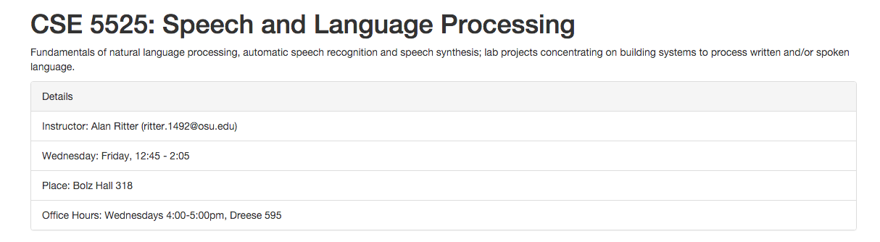
Administrative Details
Course Webpage
http://aritter.github.io/courses/5525_fall16.html

Slide 3
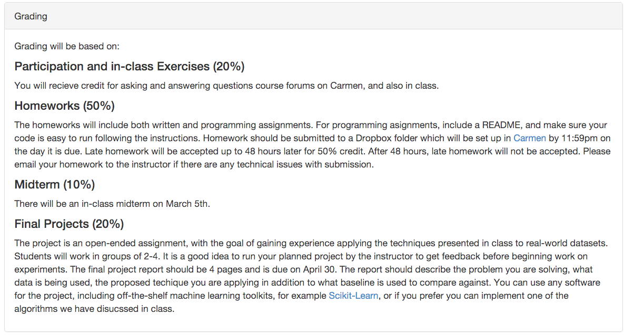
Administrative Details

Slide 4
Administrative Details
Piazza (discussion and resources)
https://piazza.com/osu/spring2016/5525/home
Carmen (homework submission and grades)
https://carmen.osu.edu/d2l/home/11684583

Slide 5
Course Details
Book
Jurfasky and Martin (2nd edition)
Will also use selections from the 3rd edition (unpublished)
Some other readings as well
Prerequisits / Assumptions
Basic Probability
Basic Linear Algebra
Python or ability to learn Python quickly
Linux/Unix (For windows users: https://www.cygwin.com/)
Numpy/scipy

Slide 6
What to Expect
Lots of math and programming
A bit of Linguistics
Computing Resources:
Experiments could take hours to run depending on with efficient code. We recommend you start early.
Questions?

Slide 7
NLP (AI) what is the goal?

Slide 8
NLP in Science Fiction (I wish we could do this)

Slide 9
Today’s NLP Applications
Speech Interfaces
Machine Translation
Search Engines
Information Extraction
Summarization
…

Slide 10
NLP Today: Speech Interfaces

Slide 11
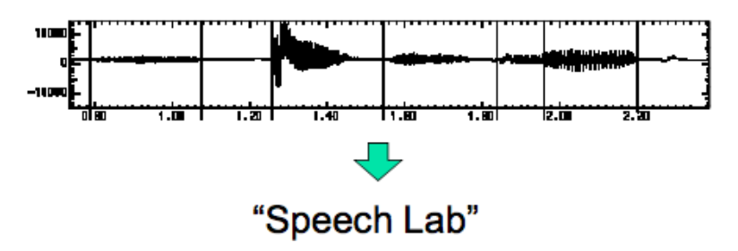
Speech Interfaces
Automatic Speech Recognition
Audio In, text out
SOTA: 0.3% error for digit strings, 5% dictation 50%+ for TV

Slide 12
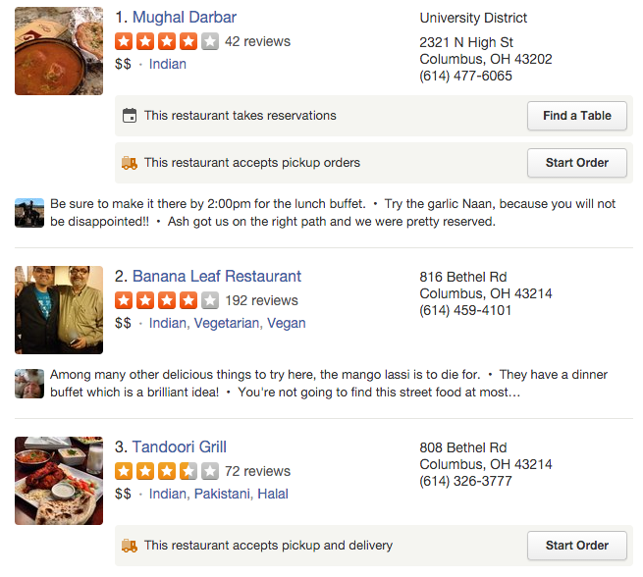
Natural Language Understanding
Convert words into semantic representation that can be used to query a database
cuisine
location
Where can I find Indian food in Clintonville?

Slide 13
Speech Interfaces
Text to Speech
Text in Audio Out

Slide 14
Question Answering

Slide 15
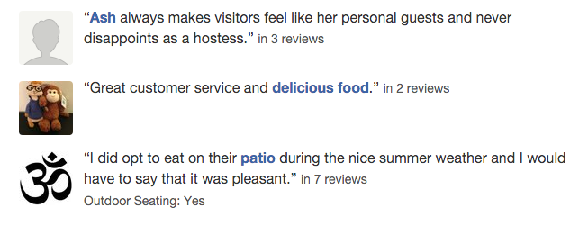
Summarization
User reviews:

Slide 16
Information Extraction
“Yess! Yess! Its ofﬁcial Nintendo announced today that they Will release the Nintendo 3DS in north America march 27 for $250”
Notes:
OK, so just to make this a bit more concrete, let’s look at an idealized version of information extraction on Twitter.

Slide 17
Information Extraction
“Yess! Yess! Its ofﬁcial Nintendo announced today that they Will release the Nintendo 3DS in north America march 27 for $250”
Notes:
Typically the first step in an IE pipeline, is Named Entity recognition.
Here you can see that I’ve just highlighted all the “entities” in this post, for example Nintendo, 3DS, the date, and price.
Doing this kind of thing automatically is the standard NLP task of “Named Entity Recognition”

Slide 18
Information Extraction
“Yess! Yess! Its ofﬁcial Nintendo announced today that they Will release the Nintendo 3DS in north America march 27 for $250”
COMPANY | PRODUCT | DATE | PRICE | REGION
PRODUCT RELEASE
Notes:
Next we might classify this post as a PRODUCT RELEASE event.
We might also have a pre-defined idea that product release events involve a company, a product, a date on which the product is released, the price and the geographical region where it is being released.

Slide 19
Information Extraction
“Yess! Yess! Its ofﬁcial Nintendo announced today that they Will release the Nintendo 3DS in north America march 27 for $250”
COMPANY | PRODUCT | DATE | PRICE | REGION
Nintendo | 3DS | March 27 | $250 | North America
PRODUCT RELEASE
Notes:
And so the information extraction task is to fill in the fields for the event.
So you could imagine many events mentioned on Twitter which fit this general schema.
If we can automatically convert tweets into database rows like this, then we can do SQL-like queries and higher-level data mining and analysis on top of this that wasn’t possible by just directly looking at the text.

Slide 20
Information Extraction
Samsung Galaxy S5 Coming to All Major U.S. Carriers Beginning April 11th
State of the art is maybe 80%, for single easy fields, 90%+
Redundancy helps a lot!
Much of human knowledge is waiting to be harvested from the Web!
COMPANY | PRODUCT | DATE | PRICE | REGION
Samsung | Galaxy S5 | April 11 | ? | U.S.
Nintendo | 3DS | March 27 | $250 | North America
PRODUCT RELEASE
Notes:
And so the information extraction task is to fill in the fields for the event.
So you could imagine many events mentioned on Twitter which fit this general schema.
If we can automatically convert tweets into database rows like this, then we can do SQL-like queries and higher-level data mining and analysis on top of this that wasn’t possible by just directly looking at the text.

Slide 21
NLP as a Field (and subfields)
Tasks (each have their own datasets and evaluations)
Syntactic Parsing
Summarization
Machine Translation
Information Extraction
…
Methods
Heuristic / Rule-based Approaches (dominated until the 1990s statistical revolution)
Probabilistic Graphical Models
Neural Networks
…

Slide 22
Q: Why is NLP hard?
Why is it easy for computers to parse Python, but not English?
A: Ambiguity!

Slide 23
Ambiguity
Example: Some Funny News Headlines
Milk Drinkers Turn to Powder
Shouting Match Ends Teachers' Hearing
Town OKs Animal Rule
Aging Expert Joins University Faculty
British Left Waffles on Falkland Islands
Local High School Dropouts Cut in Half

Slide 24
Layers of Linguistic Annotation
NNP
CD
NNP
VBZ
NNP
VBG
NNS
TO
VB
NN
IN
.
Syntax:
(Parts of Speech)
UN wants Yemen 's warring parties to resume talks on Jan 14 .
Morphology:
(stemming)
war + ing
Words:
(Tokenization)
UN wants Yemen 's warring parties to resume talks on Jan 14 .
UTF8:
UN wants Yemen's warring parties to resume talks on Jan 14.

Slide 25
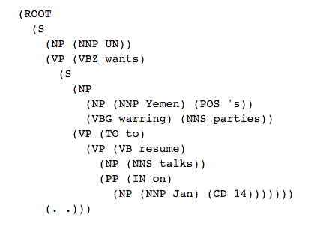
Layers of Linguistic Annotation
Syntax:
(Constituents)
NNP
CD
NNP
VBZ
NNP
VBG
NNS
TO
VB
NN
IN
.
Syntax:
(Parts of Speech)
UN wants Yemen 's warring parties to resume talks on Jan 14 .

Slide 26
Layers of Linguistic Annotation
Semantics/
Discourse:
Talks-Event
Between: Yemen’s warring parties
Mediator: UN
Date: 1/14/2016
Syntax:
(Constituents)

Slide 27
Goals for This Class
By the end of the class you should:
Be able to build basic NLP tools (translate algorithms into code)
Be able to read (and re-implement) current research papers in NLP
(hopefully) Be able to notice gaps and propose novel solutions.

Slide 28
Homework 1
Probability Refresher
Should be fairly trivial
Due before class on Friday

